Slide 1

THE CHESHIRE & WARRINGTON LEP
What We Do and How We Work
Philip Cox, Chief Executive,
Cheshire & Warrington Local Enterprise Partnership

Slide 2
LOCAL ENTERPRISE PARTNERSHIPS
38 covering whole of England
Set strategic direction for local economies
Business led, working effectively with local authorities, covering the private and public sectors with education and other local stakeholders
Develop Strategic Economic Plans, Local Industrial Strategies, Enterprise Zones
As at June 2018. To be updated when the position on all overlaps are agreed between LEPs and MHCLG, recommended in the Strengthened LEPs Review.

Slide 3
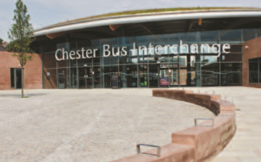
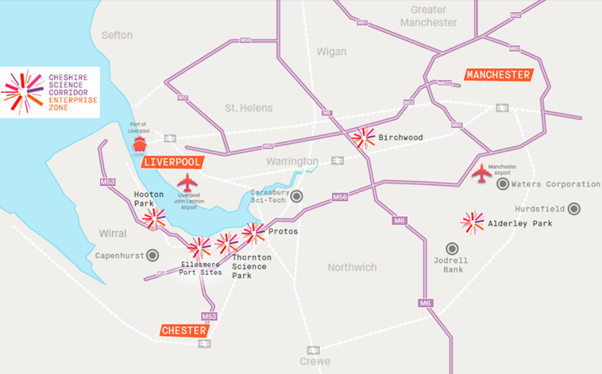
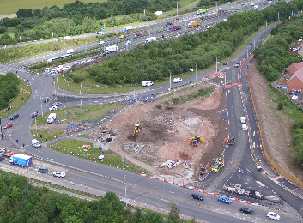
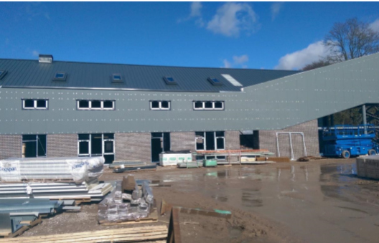
THE CHESHIRE & WARRINGTON LEP
£200 million Local Growth Fund
    Chester Bus Station; M62 Junction 8; Congleton Link Road
Cheshire Science Corridor Enterprise Zone
    Income c. £1 million pa
£12 million Growing Places Loan Fund
    Omega; Cheshire Green
European Structural and Investment Funds
    £120 million but legal responsibility remains with MHCLG
Growth and Skills Hub
    Virtual Institute of Technology

Slide 4
STRATEGIC ECONOMIC PLAN
Published in 2016/17
Commits LEP to growing Cheshire and Warrington to become a £50bn pa economy by 2040

Slide 5
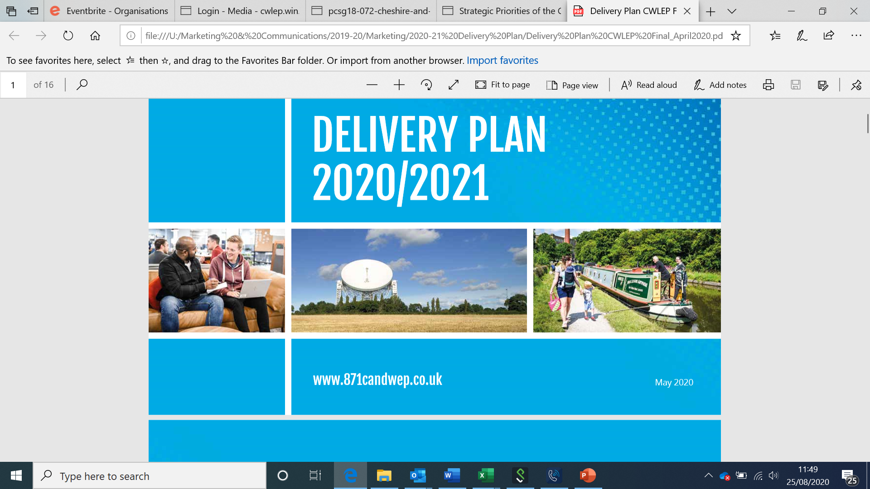
DELIVERY PLAN
All LEPs publish an Annual Delivery Plan
Key commitments for 2020/21;
    Publish our Local Industrial Strategy
    Help business prepare for Brexit
    Establish “Accelerate”
    Complete Digital Infrastructure Strategy
Economic Recovery – Post Covid

Slide 6
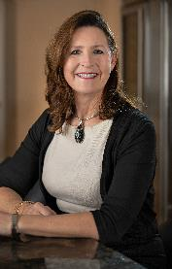
OUR GOVERNANCE AND OPERATIONS
16-member Board chaired by Clare Hayward
    LA leaders full members
    Eight sub-committees
    All meetings in public
Company Limited by Guarantee
MHCLG/BEIS Assurance and Accountability Framework
    Fully qualified Finance Director
    Overseen by Accountable Body S.151 Officer
£12 million Growing Places Loan Fund
    Omega; Cheshire Green
“Annual Conversation” with Government Officials
    Governance and Strategy rated ‘Exceptional’
Scrutiny Committee

Slide 7

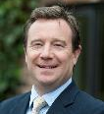
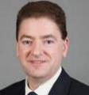
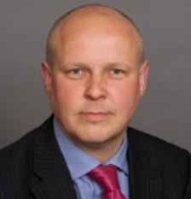
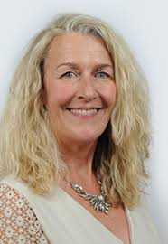
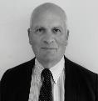
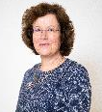
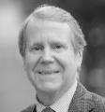
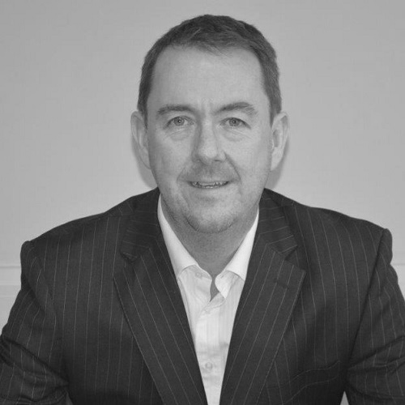

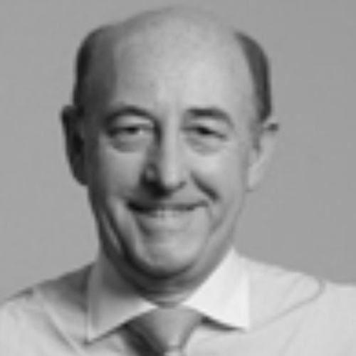
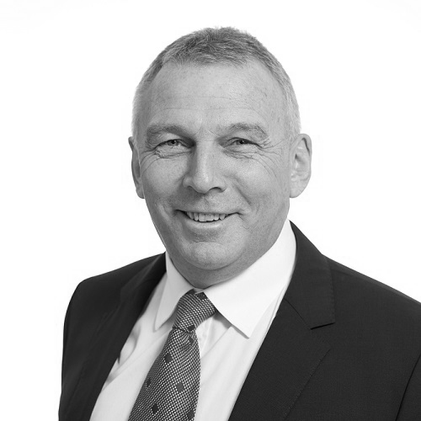
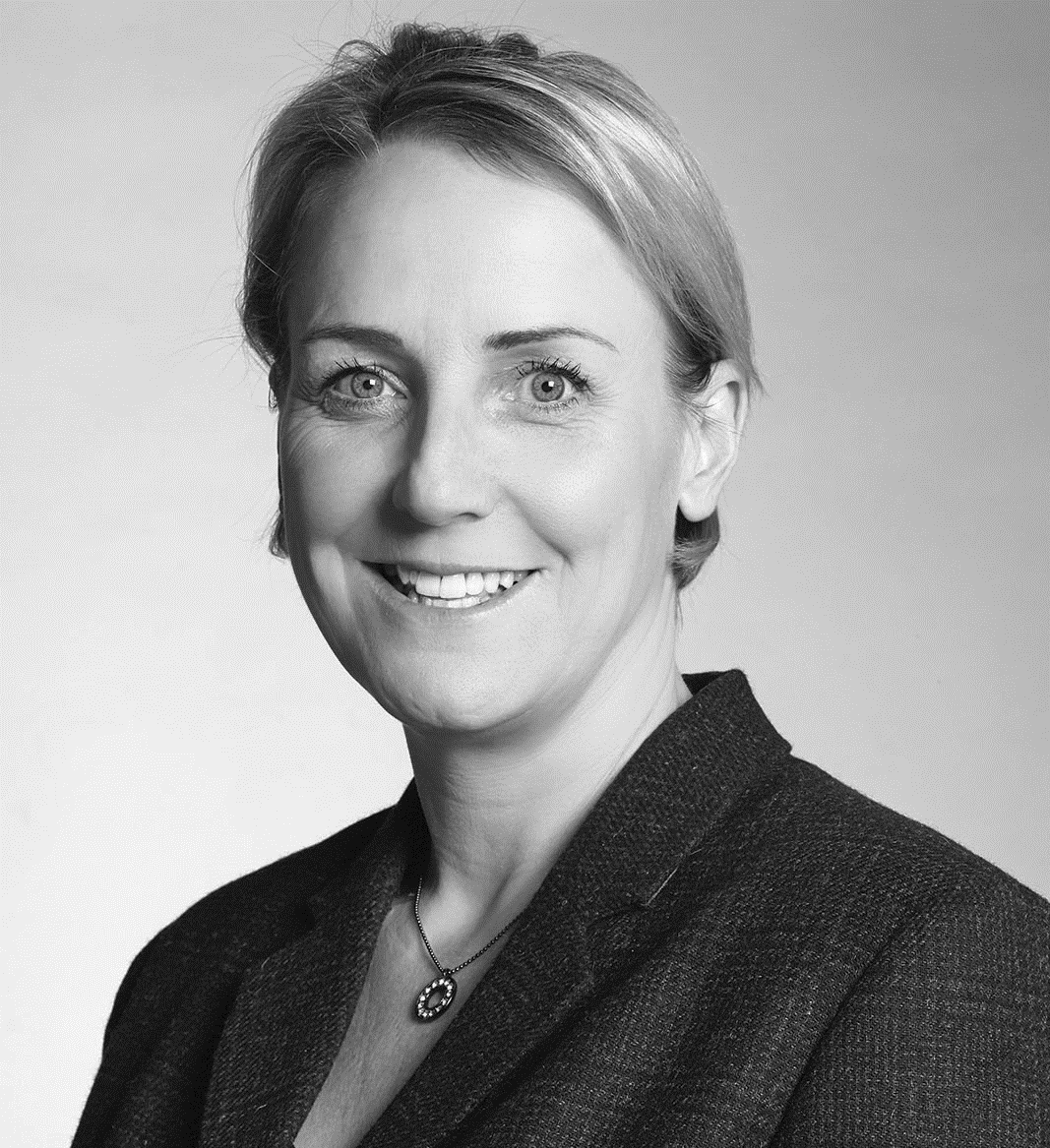
THE LEP BOARD
Clare Hayward, MBE, DL
Trevor Brocklebank
Cllr Craig Browne
Cllr Russ Bowden
Cllr Louise Gittins
Peter Broxton
Professor Eunice Simmons
Robert Mee, DL
Chris Hindley
Nicola Dunbar
Stephen Kinsey
John Downes
Nichola Newton

Slide 8

NATIONAL ASSURANCE FRAMEWORK
Up to £20 billion of public funding entrusted to LEPs Number of reviews by Public Account Committee (PAC) of LEP Transparency and Governance
Ministerial Review in 2018 leading to publication of “Strengthened Local Enterprise Partnerships” and…
National Local Growth Assurance Framework

Slide 9
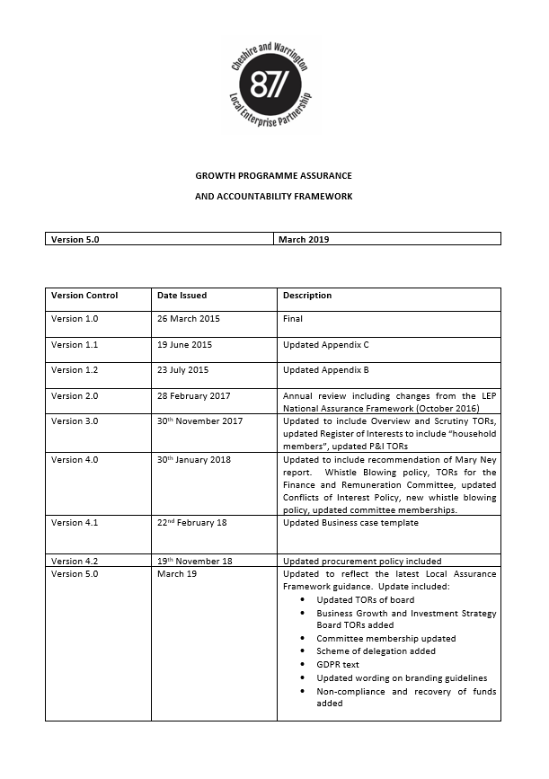
CHESHIRE & WARRINGTON LOCAL ASSURANCE FRAMEWORK
Based on National Framework, sets out C&W approach to assurance and transparency
Needs to be complied with in full
Ultimate responsibility lies with Board and Committee Members, but should expect to be able to rely on advice of officers

Slide 10
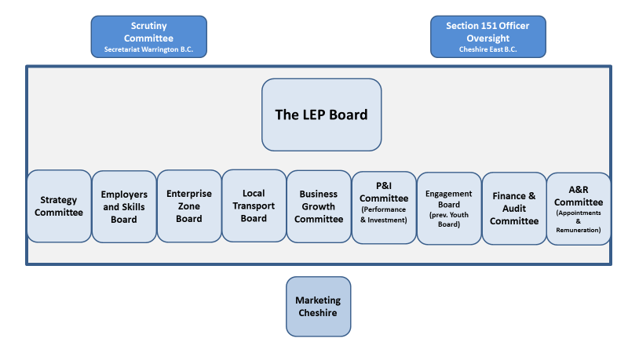
THE LEP BOARD AND ITS COMMITTEES

Slide 11
STRATEGY COMMITTEE
Debating the detail of the LEP’s Strategy
Cross cutting investment decisions e.g. Business Case prioritisation
Delegated authority - £2.5 million

Slide 12


EMPLOYERS SKILLS AND EDUCATION BOARD
Ensuring that businesses in Cheshire and Warrington can access the skills they require and residents have the skills they need to play full part in the economy
Responsible for Pledge and Virtual Institute of Technology
Delegated authority - £1 million

Slide 13

ENTERPRISE ZONE BOARD
Oversight of Cheshire Science Corridor Enterprise Zone
Decisions on investments in EZ
  Glasshouse, Alderley Park
  Aviator, Hooton Park
Delegated authority - £2.5 million

Slide 14
LOCAL TRANSPORT BOARD
Sets transport strategy for Cheshire & Warrington
Joint LA and LEP Committee
Delegated authority - £½ million

Slide 15

BUSINESS GROWTH COMMITTEE
Ensuring that businesses get the support they need to be successful
Responsible for operation of the Growth and Skills Hub
Delegated authority to be determined

Slide 16
APPOINTMENTS & REMUNERATION COMMITTEE
Appointment of Board members and non-exec Committee members
Approval of LEP Pay & Grading structure and benefits
Appointment and remuneration of Chief Executive
Ensure a set of HR Policies and Procedures are maintained

Slide 17
FINANCE & AUDIT COMMITTEE
Recommends the Annual Budget to the Board
Receives the annual accounts, auditors opinions prior to recommendation to the Board for approval
Reviews key risks, internal controls, potential liabilities facing the organisation, and approves financial policies
Compliance, whistleblowing and fraud
S.151 Officer standing member of committee

Slide 18
PERFORMANCE & INVESTMENT COMMITTEE
Responsible for ratifying all investment decisions taken by other committees
Holds LEP team to account for delivery of programme
Provides check and balance on rest of LEP
S.151 Officer standing member of committee

Slide 19

MARKETING CHESHIRE
Became a subsidiary of the LEP Summer 2019
Responsible for marketing Cheshire and Warrington as a great place to live, work, relax and study
Also responsible for all other aspects of LEP PR & Comms

Slide 20
SCRUTINY COMMITTEE
Oversight and scrutiny of all aspects of the LEP
Designed to provide reassurance to members of the public that LEP decisions are in the best interest of the people that live in the area
‘Cheshire and Warrington Public Accounts Committee’

