Slide 1
Covid-19 – Supporting the Economy through a second wave
LEP Board Meeting
Wednesday 14th October 2020

Slide 2
New national system of restrictions
PM announced new tiered approach to Covid restrictions in England on 12 October
Whole of C&W in Tier 2 – no mixing of households indoors; rule of six outdoors; 10pm curfew
Liverpool City Region in Tier 3 – bars shut but restaurants open; no household mixing outdoors
Greater Manchester also in Tier 2
Travel restrictions in Liverpool City Region and North Wales
New Job Support Scheme announced by Chancellor for businesses legally forced to close – does not apply in Tier 2 areas

Slide 3
Impact on local economies
New restrictions will have significant impact on business revenue
Bars in Warrington reported 60-90% fall in revenue following tightening of rules
Travel restrictions in Liverpool and North Wales could have negative impact on revenue in Warrington, Chester, Cheshire Oaks
People may avoid visiting Cheshire & Warrington, preferring to visit a perceived 'safer' Tier 1 location.
Central Government leading on economic support package – this presentation sets out LEP’s approach to local support measures
Regulations in place for six months – tiers to be reviewed every 14 / 28 days

Slide 4
In Summary
LEP leading Workforce Recovery Group comprising LEP, DWP, Job Centre Plus, local authorities to ensure unemployed fully supported and helped to find work
Growth Hub key point of contact for business support and guidance
Pledge programme moved online and offering more support than ever to help young people understand career options
LEP funding £1 million of grant-funded training through Accelerate
Marketing Cheshire providing lead to retail and hospitality sector
£55 million capital investment programme via LGF, Get Building Fund and EZ
Option to add further £1 million to small capital grant scheme for hospitality businesses

Slide 5
Supporting the unemployed
Extensive programme of support for people becoming unemployed due to Covid
WORKING WITH EMPLOYERS, LOCALITIES & SECTORS:
Enhanced Account Management and rapid multi-agency response to redundancies Regular (weekly) LA ‘Watch List / Touch Meetings’ Employer Working Pathfinders – Bentley & Airbus Sector Package (when clear which sectors are greatest affected) Localities Package (when clear which places are greatest affected)
INFORMATION & HELP:
Providing enhanced, tailored and navigable support and advice using information about the different persona that we need to support. Working with existing programme for unemployed to explore the scope to flex programmes so they support furloughed and newly unemployed as well as longer term unemployed.
ENHANCED START-UP:
A stronger approach to entrepreneurial start-up / self-employment support.
SKILLS & RETRAINING:
Establish and deliver coherent training programme aimed at target personas Develop a subregional ‘Talent Opportunities Portal’
GETTING ANOTHER JOB:
Helping people get another job – job matching, running a programme of job fairs & events programme, etc. Ensuring Kickstart is a success, establishing an online portal for job matching
INTELLIGENCE:
Continual development of the dashboard and sharing of labour market intelligence
INTO WORK BOARD:
Supporting people with multiple barriers to work – reducing long-term unemployment Improvement of local authority services to tackle population well-being Delivery of current programmes and the development and delivery of new shared projects
COMMUNICATIONS & MARKETING:
Communications campaigns Develop a subregional ‘Talent Opportunities Portal’

Slide 6
Supporting business through the Growth Hub
Growth Hub supported 1200 business March - September
75% of enquiries for support in response to Covid-19
Signposted 700 to Covid-19 Gov.uk resources
Referred 350 to support programmes: 46% to finance/funding, 27% mentoring, 20% skills/training, 7% innovation
20000 users of the Growth Hub website; 61000 page views
Delivered a programme of webinars: restart, working safely and sector led
Working with our business networks, BIDs and regulatory bodies

Slide 7
Supporting young people through The Pledge
Continuing engagement with schools, young people and employers through The Pledge
8,500 attended virtual careers Expos in Warrington and Macclesfield
Three more planned in for this week

Slide 8
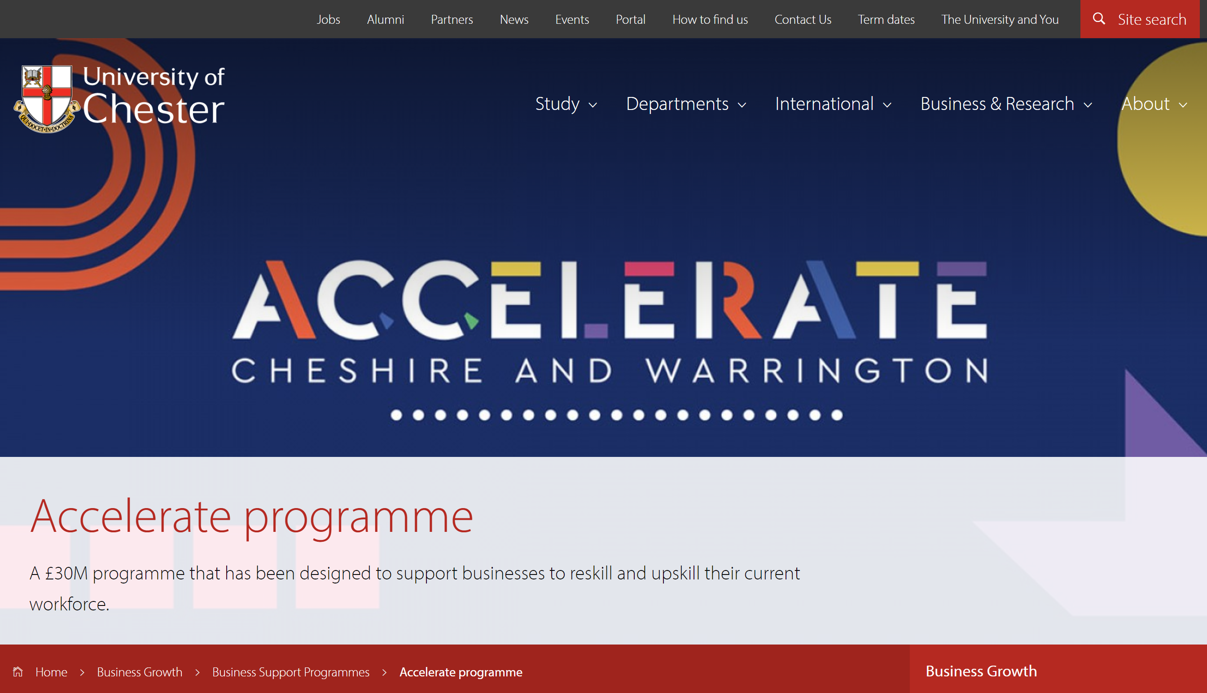
Providing re-training through Accelerate
£30 m Accelerate training programme to provide 40% of the cost of reskilling workforce
LEP providing £600K to match £400K of European Funding to enable 100% funding of training in businesses employing fewer than 50 employees
Review currently taking place to identify ways of streamlining the programme and making it more attractive to businesses

Slide 9
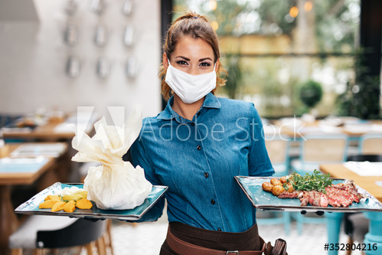
Supporting businesses through Marketing Cheshire communications
The cinema, just how you always wanted it to be
Enjoy #socialdistancing in Chester
Working with LAs, BIDs and town councils on 'Open for Business Together' comms campaign to showcase businesses who have innovated and are doing everything they can to be Covid-secure
Continuing with a programme of webinars and forums with the BIDs to provide guidance on how businesses can adapt in line with the restrictions, and to showcase best practice
Continuing to develop Autumn and Christmas communications to inspire residents and visitors and support local businesses
Deliver marketing and communications to promote LEP recovery initiatives – Growth Hub, Pledge, Accelerate, Workforce Recovery
@Storyhouse Chester
11am is the new 11pm - 20 new brunch spots in Cheshire

Slide 10
Delivering our capital programme
Investing £25 million this year in Local Growth Fund projects
£15½ million to be invested by March 2022 in Chester, Warrington and Alderley Park through Get Building Fund
£11 million being invested in five schemes through Enterprise Zone programme
Additional £5 million to be invested as soon as EZ loans are drawn down
Opportunities for further early investment if Government gives early agreement to High Speed Growth Corridor

Slide 11
Expanding our support offer
Tier 2 restrictions (plus Tier 3 in adjoining areas) will hit hospitality sector. Bars & restaurants will face continued drops in revenue but won’t be able to access national support mechanisms
Potential further £1m of funding from Growing Places Fund (GPF) available to deploy as small capital grants – likely to enable us to help another 400 companies to innovate to improve revenue and Covid-security
Builds on existing programme being operated for us by Blue Orchid. Would be targeted at businesses adversely affected by new restrictions – predominantly hospitality businesses
Each project is good value for money in its own terms – decision for Board is whether retaining the money in GPF offers better value in the long term
Formal paper attached at annex

