Slide 1
Building Back Better Together
Accelerating Recovery Post Pandemic

Slide 2
Purpose of the Recovery Plan
Sets out the LEP’s role in delivering the new sub-regional vision – making Cheshire and Warrington the UK’s most ‘Healthy, Sustainable, Inclusive and Fast Growing Economy’
Contains a mixture of long-term strategic vision, medium-term pathways and short-term deliverables
Identifies practical steps that can be taken in the short term to get the economy moving and people back in employment

Slide 3
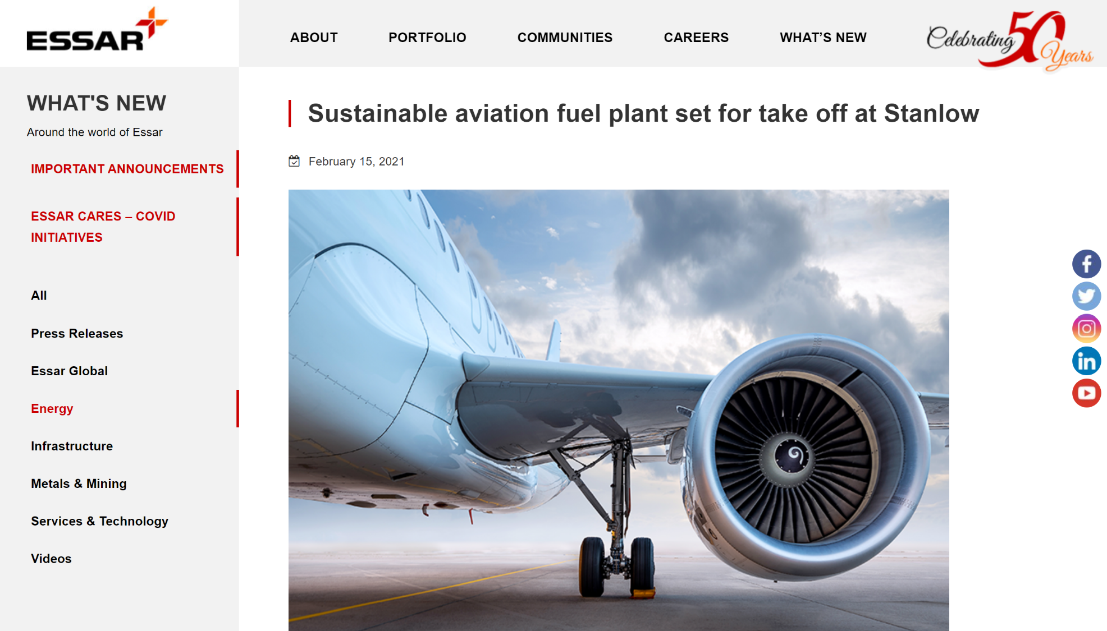
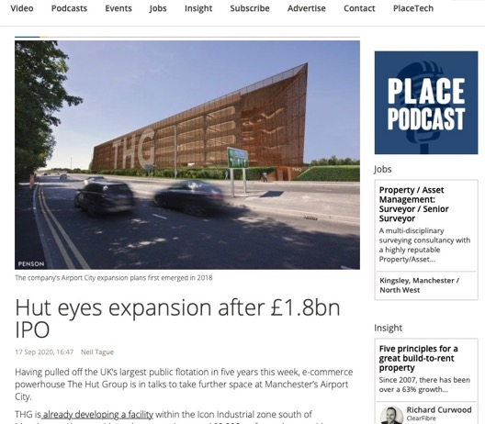
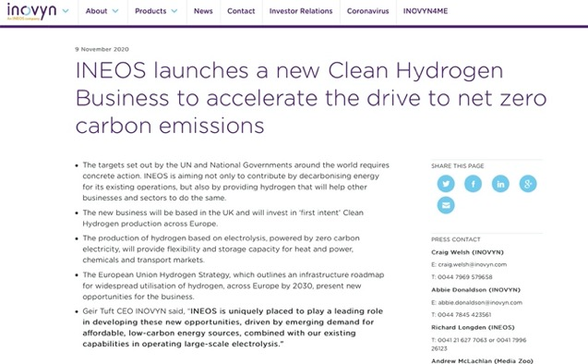
Building on underlying economic strengths
Large sections of economy continued to function after an initial period of adjustment
Covid has Accelerated change in how business and industry operates
Stimulating innovation
Notes:
But it’s important to stress that it’s not all bad. Large sections of the economy have continued to function after an initial period of adjustment (indeed NWBLT hosted a session a couple of weeks ago that heard from Encirc, Northern Rail and Bruntwood on how they had adapted and bounced back.
The crisis has accelerated a number of positive changes in how business, industry and consumers operate (shift to digital channels, move to cashless payments) which are likely to result in a boost to productivity, at least in the short term. We do have to be aware though of the risks that these shifts could in themselves leave some people behind.
And the pandemic has really stimulated innovation, not least in how we develop and trial vaccines!

Slide 4
Strategic Objectives
Supporting wider public sector and civil society as they lead the recovery in the health and wellbeing of our communities, including the mental wellbeing of workers and business owners.
Demonstrating that Cheshire and Warrington is at the heart of the Green Industrial Revolution, ready to deliver the government’s 10-Point Plan with clear proposals for decarbonising our economy and creating green jobs.
Unlocking investment to provide opportunity and growth for all our communities, levelling up economic disparities, supporting those sectors hardest hit by the Covid-19 pandemic to recover, and boosting our town centres and high streets.

Slide 5
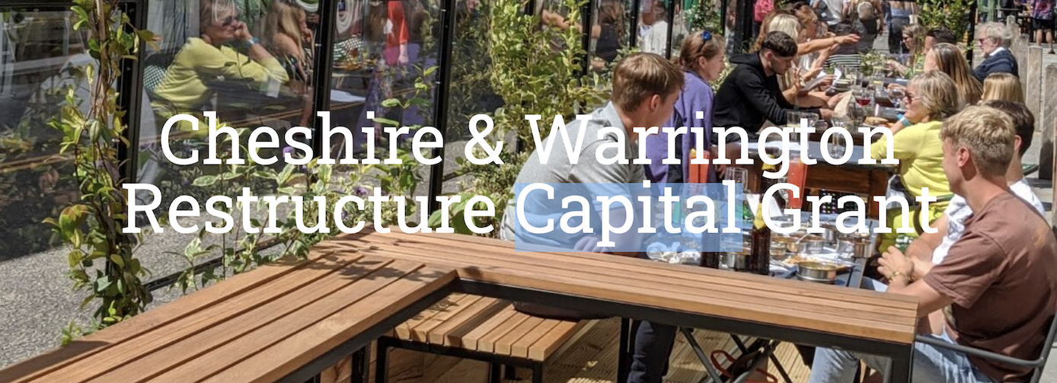
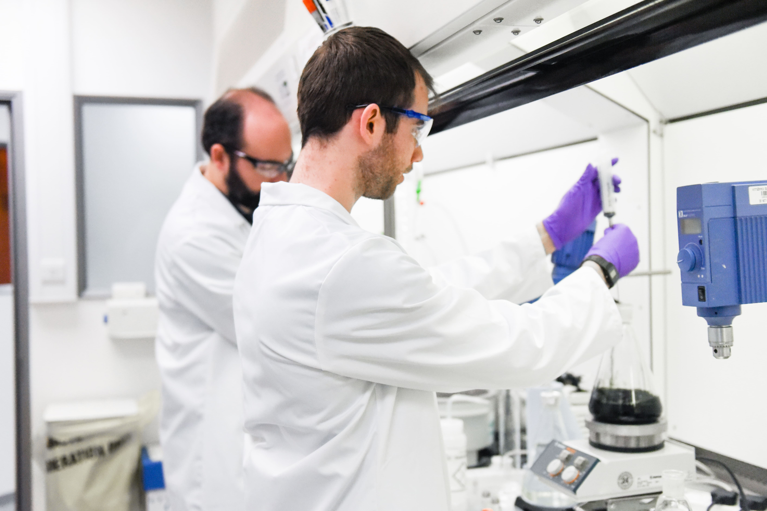
Health & Wellbeing
Supporting businesses to adapt and stay Covid-secure
Becoming a global leader in complex medicines
Supporting wider public sector and civil society efforts to boost health and wellbeing of communities
Highlight support for mental wellbeing of workers and business owners

Slide 6
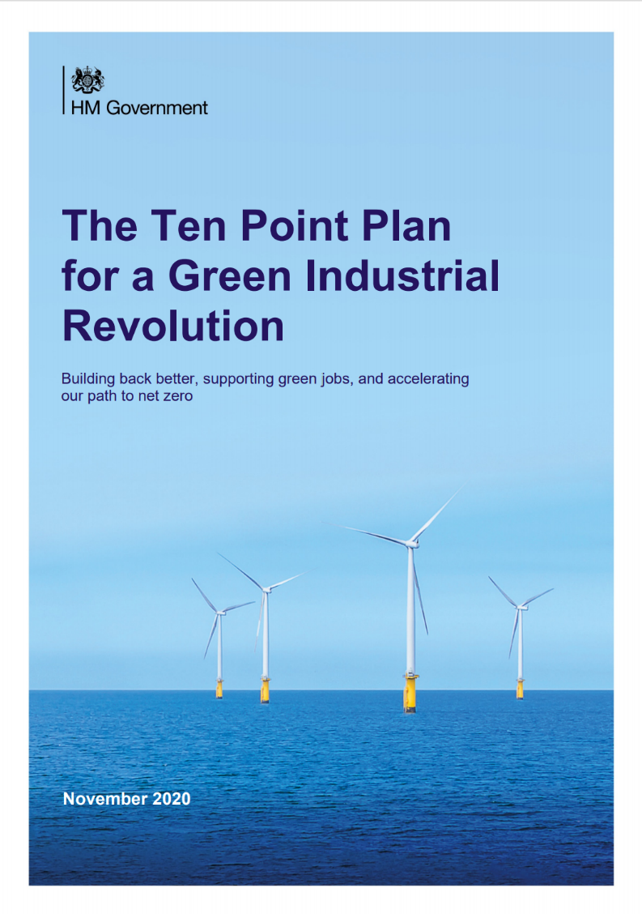
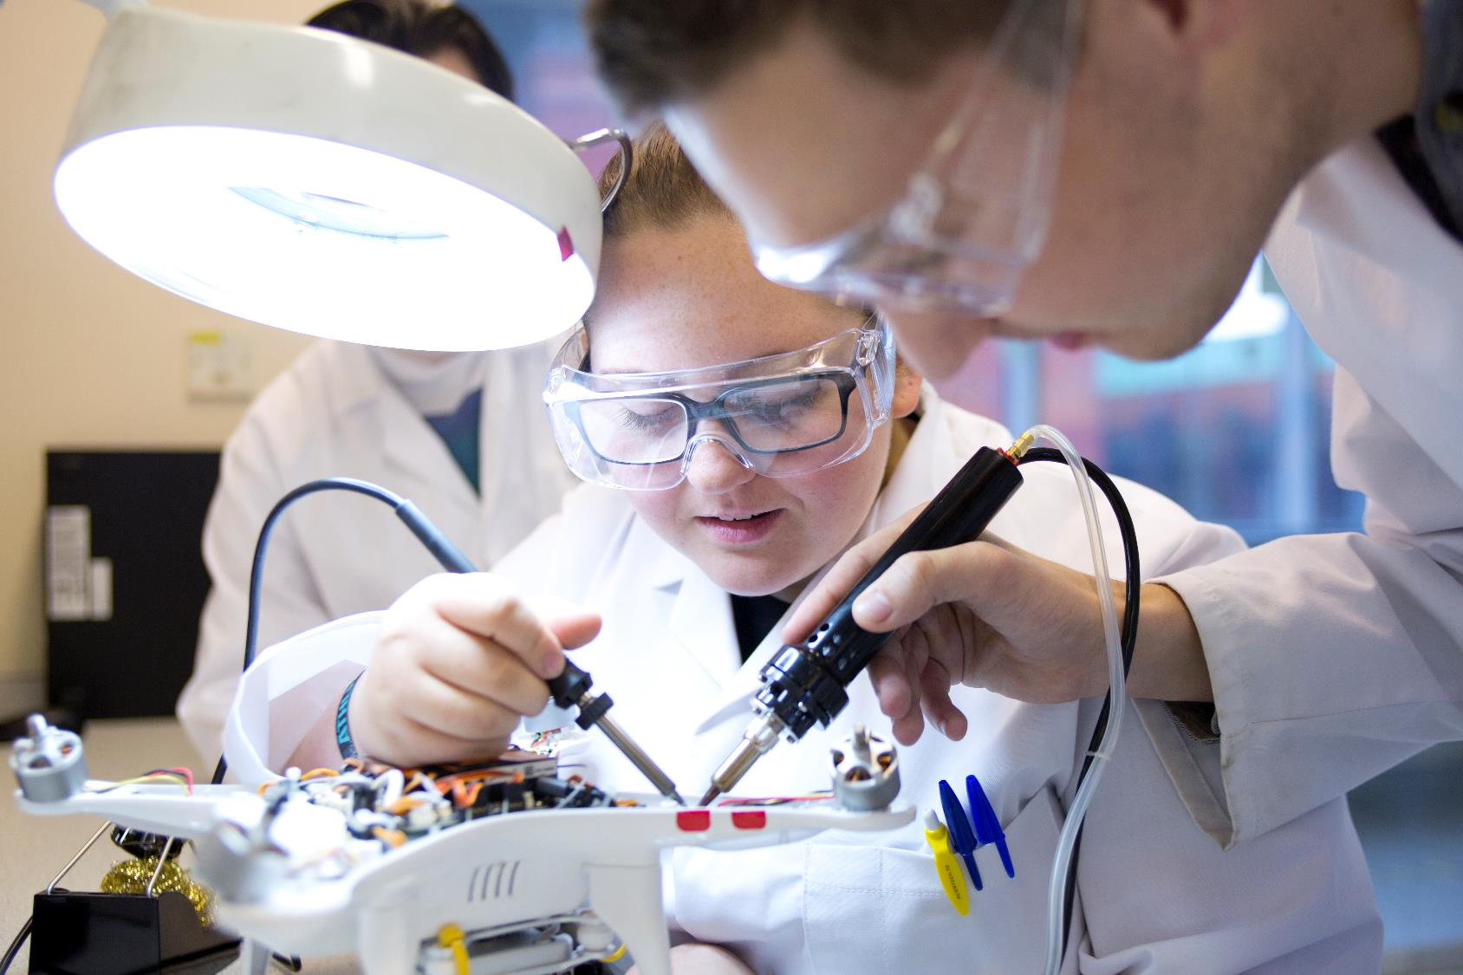
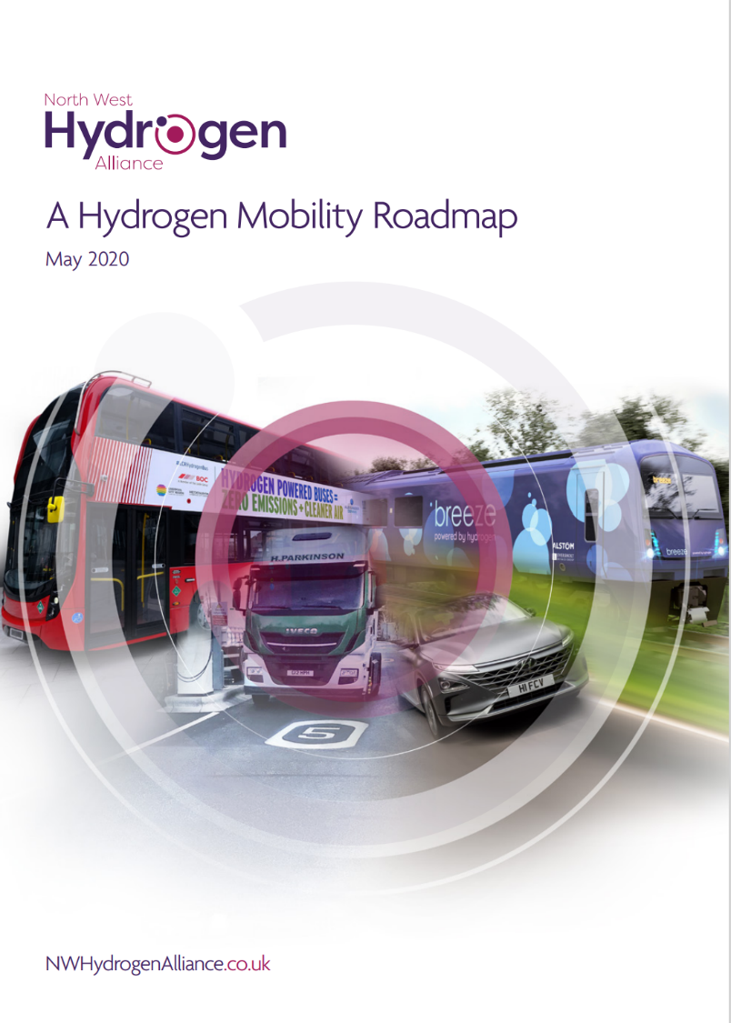
Sustainable
Putting Cheshire and Warrington at the heart of the Green Industrial Revolution – supporting and advocating for key business cases
Working with employers and training providers to understand the skills and employment opportunities
Initially focussing on the hydrogen economy, new nuclear, smart energy systems and role of natural capital in decarbonisation

Slide 7
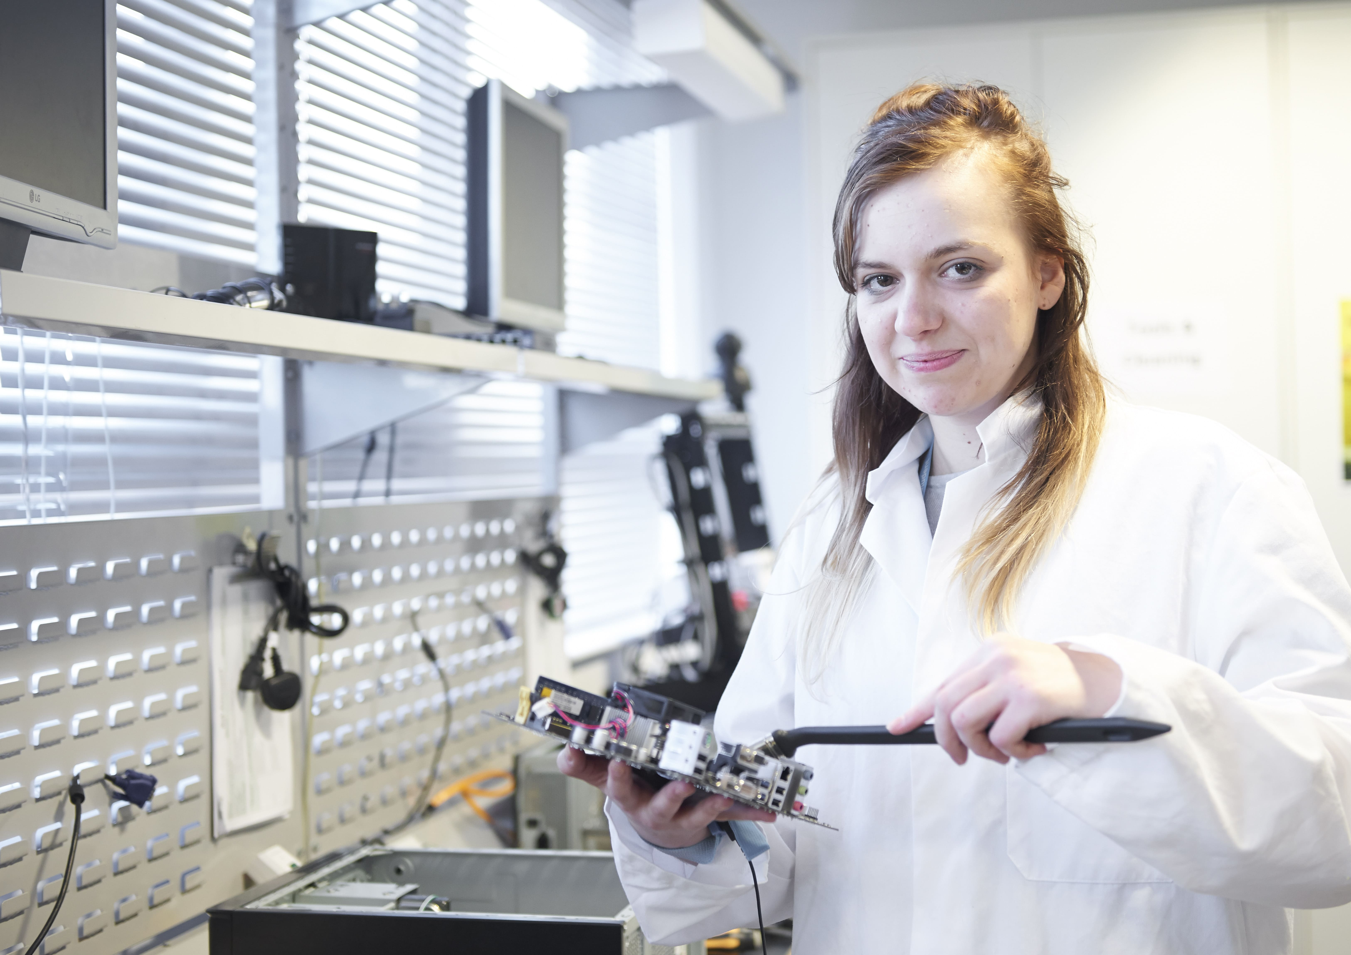
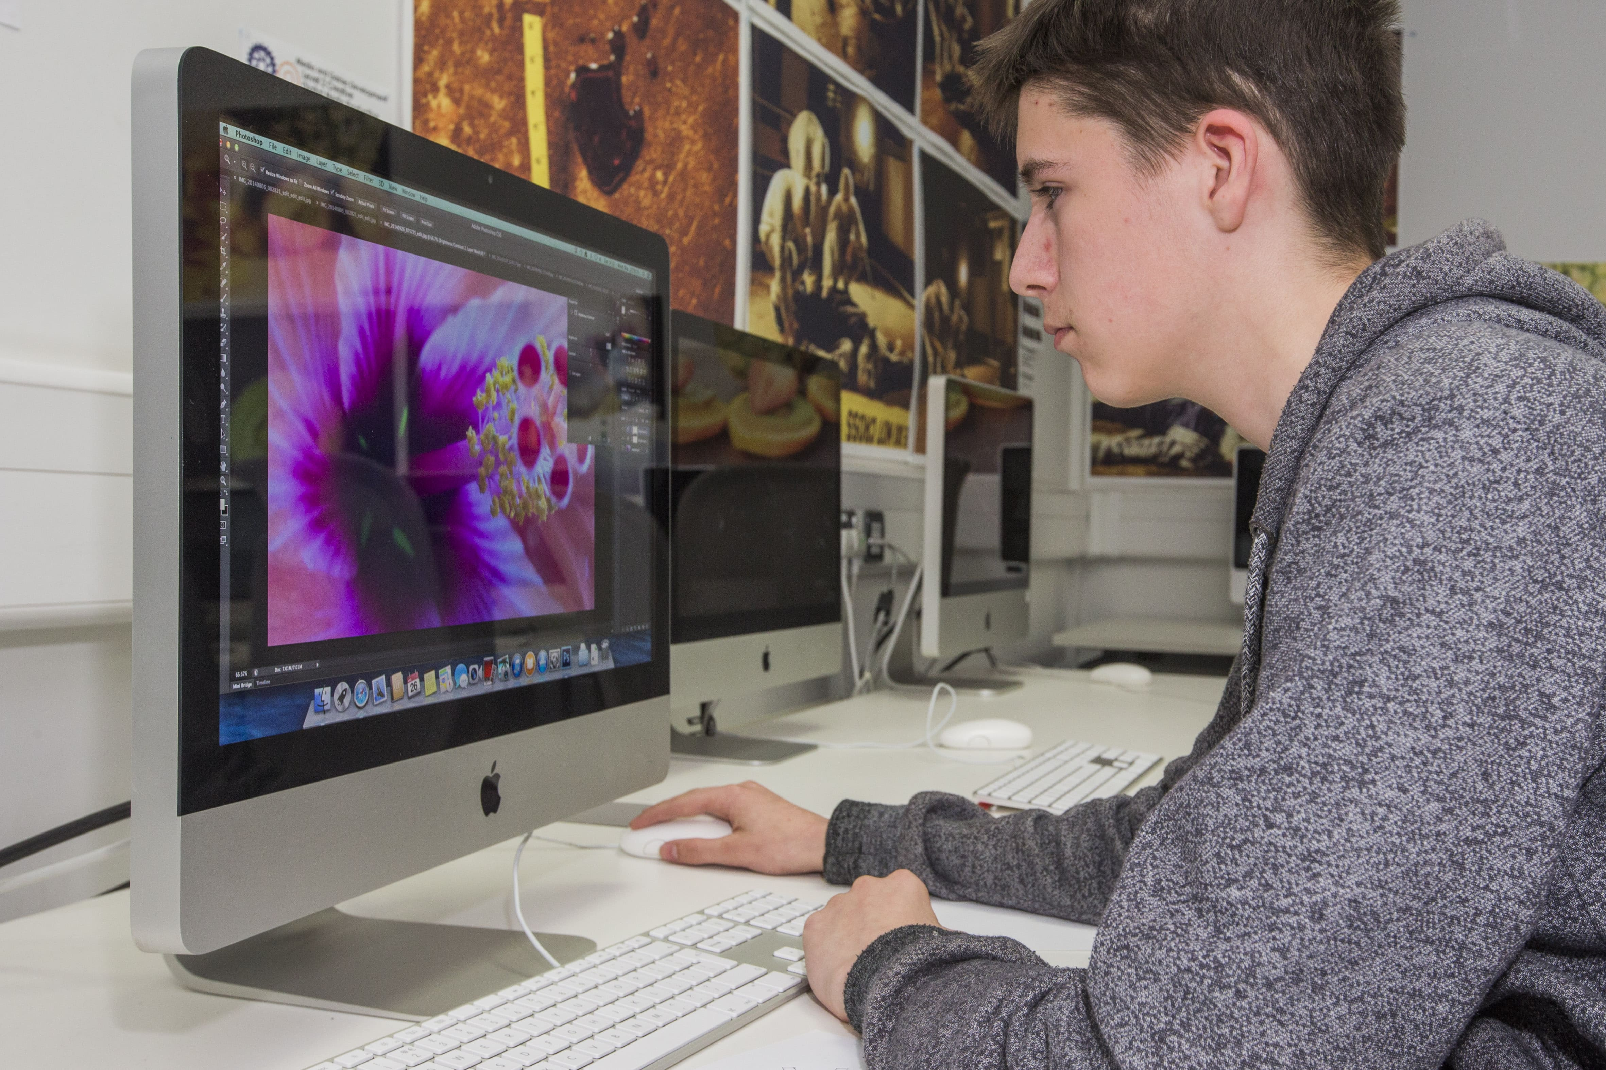
Inclusive
Getting people, especially the young, back into work, post-pandemic
Inspiring young people to get the skills they need for the modern economy
Capitalising on the opportunity presented by HS2 and Northern Powerhouse Rail (High Speed Growth Corridor)
Supporting the reinvention of town centres and high streets

Slide 8
Foundations for growth
Skills & Labour Markets
Young people
Innovation & ideas
Energy innovation
Connectivity & Infrastructure
Investment Pipeline business cases
Business Growth
Trade & Investment
Employers
Economically inactive & unemployed
Life Sciences – complex medicines
Manufacturing - Industry 4.0 and AI
Strengthening the Growth Hub
Supporting hard hit sectors
Promoting sustainable travel
Boosting digital inclusivity & connectivity

Slide 9
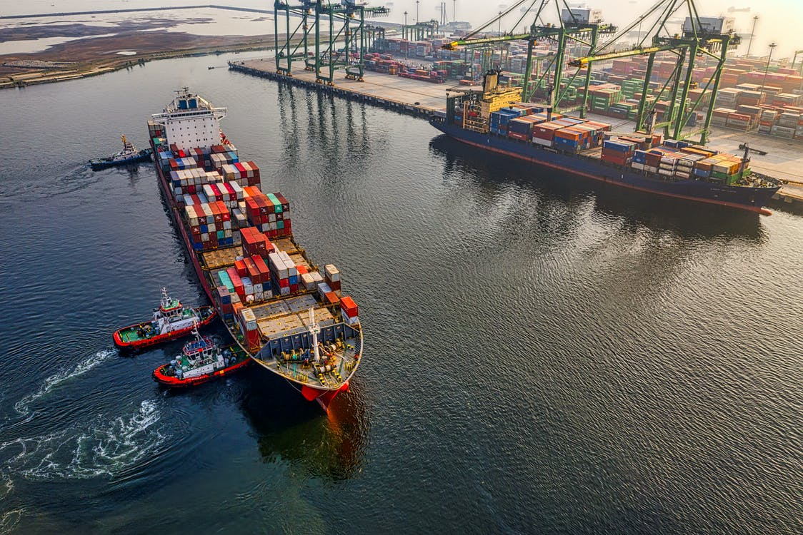
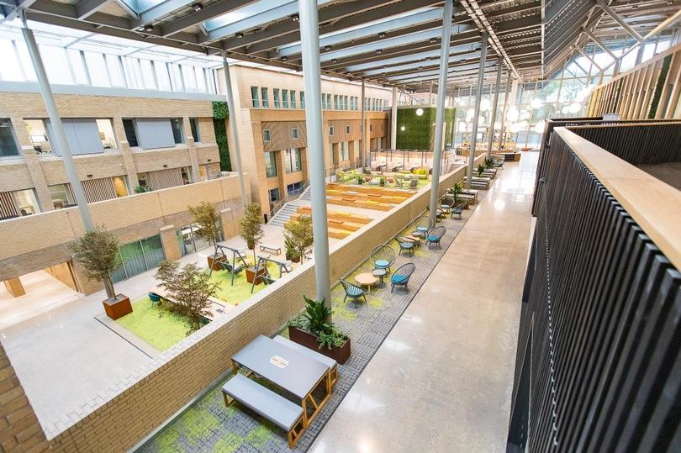
Building the foundations
Supporting Business Growth with a new export strategy and peer to peer networking
Improving our connectivity and infrastructure by delivering our Digital Infrastructure Strategy, and investing in our transport network, especially active travel
Putting innovaton and ideas at the heart of our growth by investing in the Science Corridor
Improving our skills and labour markets by investing in the Accelerate and Institute of Technology programmes

Slide 10
Practical action
Launch of Sustainable & Inclusive Growth Commission (September 2020)
Accelerating investment in Cheshire Science Corridor Enterprise Zone
11,000 learners benefiting from Local Growth Fund Skills investments by December 2021
Business Case for Institute of Technology submitted by April 2022
£1m+ in capital grants provided to Cheshire & Warrington SMEs
£1.5m invested in development of business cases for new and improved infrastructure

