Slide 1


Overview and Digital Skills

Slide 2


DCMS and Local Digital Skills Partnerships
The aim of the DSP is ambitious: to improve digital capability across the whole skills spectrum - from the essential skills that help reduce digital exclusion, to the skills workers need in an increasingly digital economy, and through to the advanced skills required for specialist roles.

Slide 3

Digital Skills Partnership
What is the Digital Skills Partnership?
The Digital Skills Partnership is a group of employers and other organisation who recognise the growing importance of digital skills to all the businesses and residents of Cheshire and Warrington.
What is it for?
The Digital Skills Partnership will ensure that we focus on digital skills as we deliver the two priorities of our skills and education action plan:
Businesses being at the heart of inspiring and informing young people about new technologies and career opportunities so they make informed decisions about the training and education that they choose; and
Businesses working together with training providers to improve the quality of training available to employees and individual learners who want to acquire the digital skills they need for work or to function in an increasingly digital age.

Slide 4

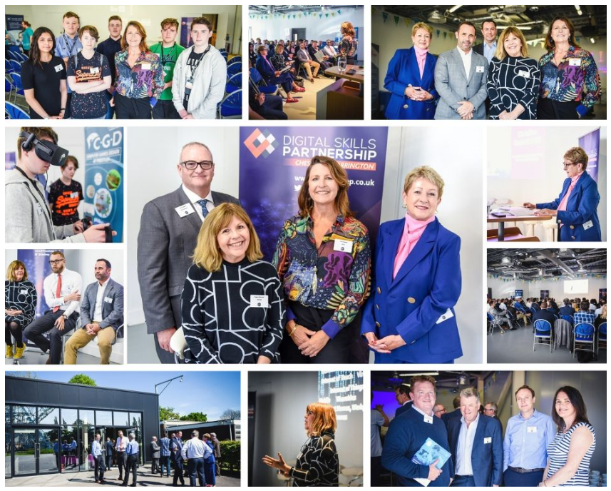
Digital Skills Partnership
How does it help me?
The Digital Skills Partnership will work together with businesses and training providers to develop the skills of the current and future workforces to enable them to take full advantage of new digital technologies.
It will also help residents and employees across Cheshire and Warrington to acquire the digital skills they need to live in an increasingly digital economy and move into work or to progress in work.

Slide 5
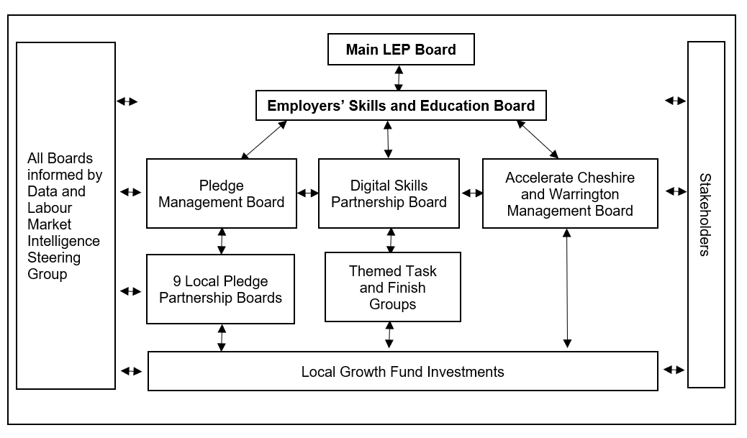
DSP Board and Stakeholders

Slide 6












Connecting - Stretching - Improving Digital Capability
Cheshire East – Cheshire West and Chester - Warrington
CURRENT
OBJECTIVES
ENABLERS
STAKEHOLDERS
HOW
IMPACT
SITUATION
Digital, turbulent, fast paced, competitive workplace
1
Increase number of digital and STEM qualified / trained people acquiring digital skills to work and function in a digital age
Improved economic
and labour market intelligence
Collaborative working with regional and national stakeholders through the local digital skills partnership
Joined up initiatives from Government including DCMS
Aggregated employer demand
Flex between capital and revenue budgets
Success of the
Growth Hub
Inclusive: primary, secondary, young people and those upskilling and reskilling
Use of existing funding streams
Use of apprenticeship levy and Adult Education Budget
Benchmark outcomes and share good practice
Third sector partnerships to support inclusion
Employers
Young people
Workforce
Schools, Colleges and Universities
Youth workers
Unemployed and JCP
Economically inactive
Parents
DCMS
Local authorities
Training providers
Enterprise coordinators
and advisors
National Career Service
Voluntary sector
1
UPSKILLED, PRODUCTIVE WORKFORCE
DIGITAL SKILLS PARTNERSHIP
Mismatch between employers’ future skills needs and learning available creating skills gap
2
Improve digital inclusion across the region to provide opportunities for all
Too many initiatives not joined up and lack of continuous learning programme
3
Increased number of individuals retraining and upskilling in digital skills
EMPLOYERS SKILLS AND EDUCATION BOARD
2
IMPROVED PRODUCTIVITY
Young people and parents not aware of job and opportunities future career pathways
Coherent and accessible essential digital skills delivery programme in place that promotes
continuous development of skills
Delivery of digital skills training how, when and where employers need it to ensure business growth and improved productivity
Employers engaged with the future workforce and clearer pathways enabling young people to make career choices in Digital and STEM
Increased % of young people undertaking Digital and STEM related work placements.
Actively engaged network of stakeholders
Increased growth, resilience and innovation through digital skills
Improved industry productivity and sustainability through better use of technologies
3
BUSINESS GROWTH AND RESILIENCE
Fewer than 2% of work experience placements are Digital or STEM related
Not enough young people are taking STEM or Digital A-levels: 26% compared to 29% nationally
4
INSPIRED AND INFORMED PEOPLE
Increasing number of low productivity jobs
ACCELERATE CHESHIRE AND WARRINGTON
Diverse population to include e.g. excluded children, ageing workforce
5
ECONOMIC AND DIGITAL INCLUSION
Need to turbo boost current digital skills activity

Slide 7
Connecting - Stretching - Improving Digital Capability
Cheshire East – Cheshire West and Chester - Warrington
4
Coherent and accessible essential digital skills delivery programme in place that promotes
continuous development of skills
Delivery of digital skills training how, when and where employers need it to ensure business growth and improved productivity
Employers engaged with the future workforce and clearer pathways enabling young people to make career choices in Digital and STEM
7
Increased % of young people undertaking Digital and STEM related work placements.
Actively engaged network of stakeholders
Increased growth, resilience and innovation through digital skills
Improved industry productivity and sustainability through better use of technologies
OBJECTIVES
1
Increase number of digital and STEM qualified / trained people acquiring digital skills to work and function in a digital age
8
5
9
2
Improve digital inclusion across the region to provide opportunities for all
6
10
3
Increased number of individuals retraining and upskilling in digital skills

Slide 8
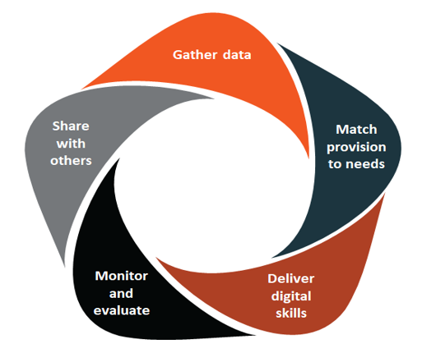
Suggested Key Priorities for DSP
1) Sharing good practice and connecting programmes, investments and infrastructure. Drawing in national expertise (via DCMS) to support activity. Digital Champions.
  Cheshire and Warrington LEP programmes
  Other programmes (Made Smarter, Manufacturing Growth Fund, others…)
3) Data & Labour Market Intelligence and Stakeholder engagement.
3
1
1
2
2) Inclusion work
  Working with partners including - Job Centre Plus, doctors surgeries, housing associations, local authorities, libraries and community centres.
  Develop coherent network of digital champions to support this.
3
2
1

Slide 9
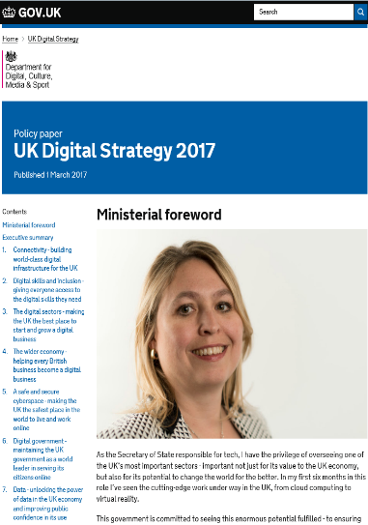

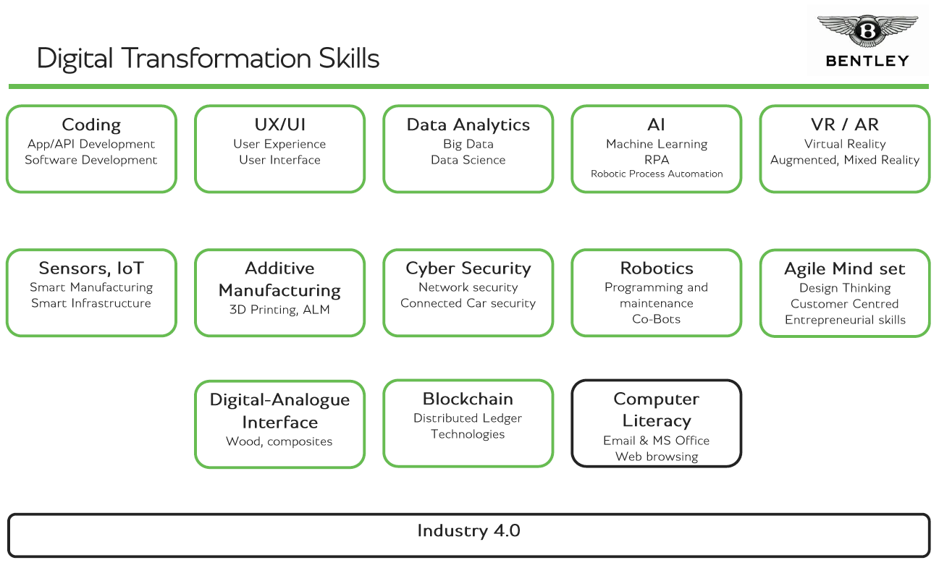

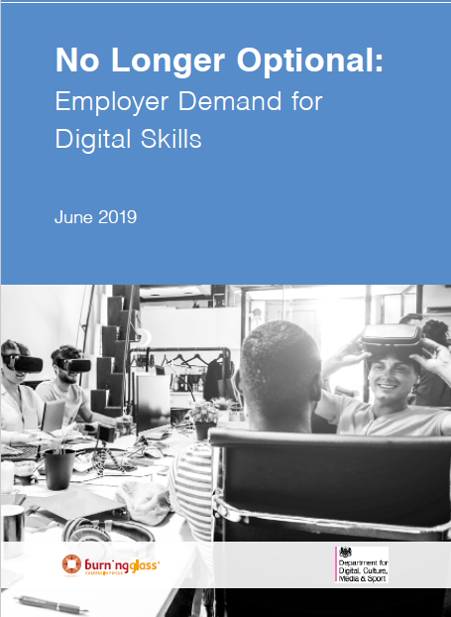
Digital Skills Work

Slide 10
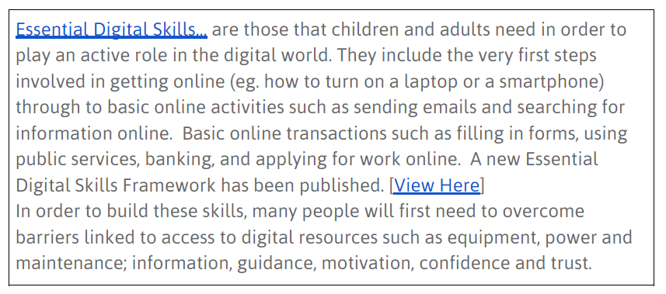
Digital Skills
Essential Digital Skills
General Digital Skills
Specialist Digital Skills

Slide 11
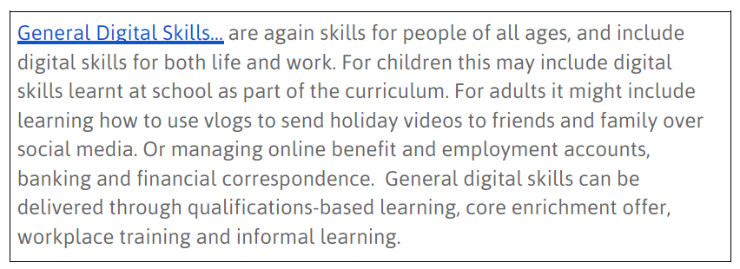
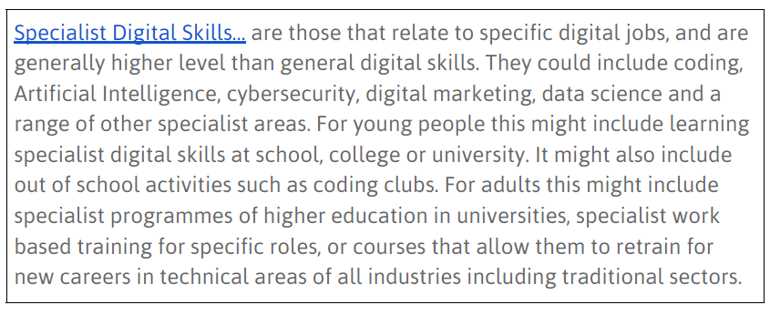
Digital Skills

Slide 12
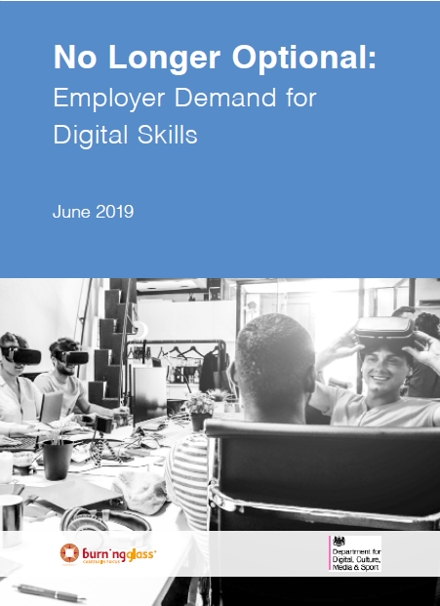
Digital Skills
Baseline digital skills: productivity software skills
Advanced digital skills: this category includes seven clusters of digital skills: Programming skills, Computer and networking support, Data analysis, Digital design, Customer Relations Management (CRM), Digital marketing and Machining technology.
(Burning Glass, 2019)

Slide 13
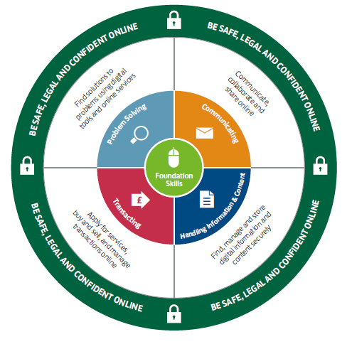
Essential Digital Skills Framework

Slide 14
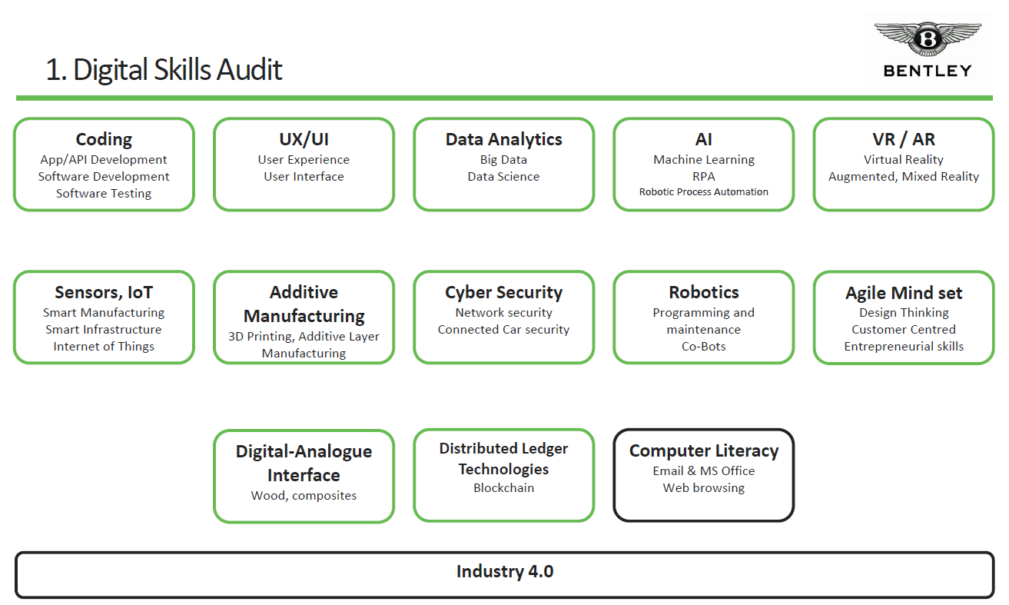
Skills Map Examples

Slide 15
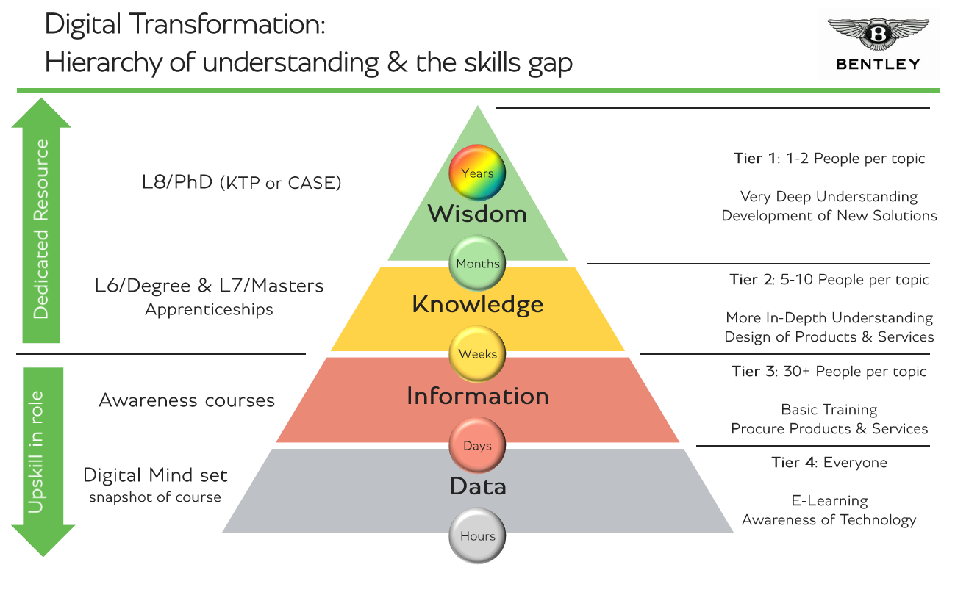
Skills Map Examples

Slide 16
Cheshire and Warrington Digital Skills Partnership Coordinator
Sarah Williams
sarah.williams@871candwep.co.uk 07506 478 681

