Slide 1
New Hospitals Programme Update
Lucy Gardner, Director of Strategy and Partnerships

Slide 2
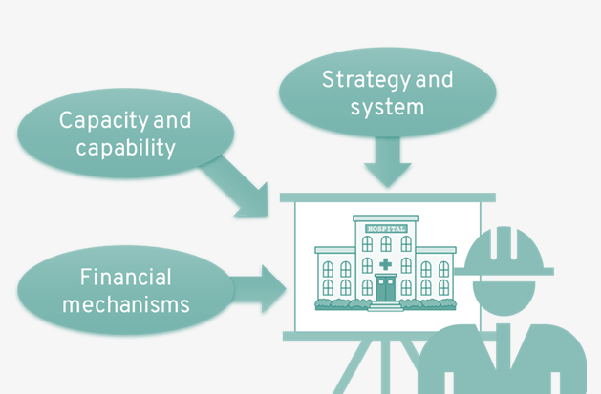
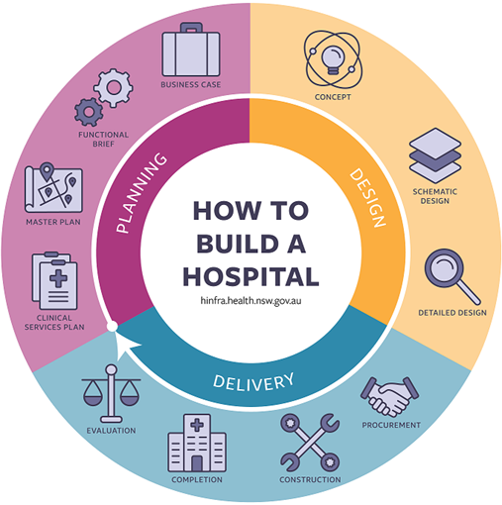
New Hospitals Programme
CASE STUDY
In development
Project Overview
What are we doing?
As part of the Government’s planning for a world leading healthcare system, Warrington and Halton Teaching Hospitals NHS Foundation Trust has submitted a proposal to secure one of the last remaining eight places in the national new hospitals programme, which will provide grant funding for new hospital estate.
Our innovative, value-for-money plans seek investment to build a new hospital for Warrington and to create a hospital and wellbeing campus at the Halton Hospital site, including a significant extension to the Captain Sir Tom Moore building. This would enable us to connect physical and mental health services. Our hospitals will be a focal point for the community, with integrated health and wellbeing facilities, enabled by collaborative working across local partners.
Building new hospitals requires us to consider many factors. The immediate priority is to secure investment from central Government. A key factor will be demonstrating the case of need and the financial return on investment. We have identified that we could deliver a sizeable return on investment of £5 for every £1 spent on building our new estate.
Additionally, we have: -
Produced a business case to establish the need for investment, to appraise the main options available and to recommended a preferred way forward;
Conducted a site feasibility study to explore where a new Warrington Hospital should be built.
Why are new hospitals needed?
The Stakeholders
Next steps and timescales
We want to build on what our hospitals are already great at, while developing new cutting-edge hospital facilities that take advantage of new healthcare technologies and treatments to offer the absolute best in modern healthcare for our patients.
Despite the excellent care provided by staff, the age and layout of our existing hospitals make them incompatible with modern healthcare standards. For example, to comply with new ward standards we would need to remove half of our current beds from the hospital. Equally, it is costing us more money each year to simply maintain the estate and we could get better value spending this money elsewhere.
Our plans are much more than a ‘bricks and mortar’ new hospital. The benefits are far greater. We will attract investment and jobs to Warrington and Halton, benefitting everyone by boosting our local economy. Modern buildings will enable new care models which will allow more care to be delivered in accessible community locations – improving access and reducing health inequalities, and reducing waiting times for diagnostics and procedures.
The Trust, its commissioners, local government, educators including the University of Chester, social care, third sector representatives and MPs are wholly united to deliver future-proof, adaptable and appropriate healthcare facilities for our communities.
Objective | Timeframe
Receive the outcome of the expression of interest for grant funding from the national new hospitals programme. | Summer 2022
Explore opportunities to maximise use of existing public sector estate across Warrington and Halton to ensure quality service provision is retained | Summer 2022
How will we measure success?
Contact details
Success will be measured by attracting investment to build new hospitals. Through this we expect to improve health outcomes, decrease the money spent on backlog maintenance and increase the number of patients accessing care closer to home, while accelerating the regeneration of both towns.
Kelly Jones – Head of Strategy & Partnerships
Kelly.jones66@nhs.net

Slide 3
Recap of the New Hospitals Journey
2020
Recognition of the need for new hospital facilities across Warrington and Halton led to creation of the New Hospitals Programme. This built on previous estates work across both sites.
Sep-20
SOCs were developed and reviewed by NHSEI through an informal gateway review process.
Both SOCs were approved by Trust Board and supported by local partners (CCGs, LAs, University of Chester and MPs)
Feb-21
Detailed costing exercise carried out by Turner & Townsend. Estimated total project costs (including full construction, external and internal support, optimism bias, inflation) were provided.
Sep-21
EOI submitted for HIP funding
Dec-21
Work commenced to enhance the financial and economic cases of the SOCs, aligned to new NHSEI guidance.
A review of planning assumptions and costings commenced to ensure SOCs remain contemporary.
Mar-20
A Case for Change was developed to clearly articulate the need for new hospital estate.
Oct-20
A Value for Money (VFM) paper was produced which reviewed the costs and benefits of the schemes for both Warrington and Halton. This took the overall VFM figure in the SOCs from 52% up to 122%.
Jun-21
A high level affordability assessment was undertaken based on the new capital cost estimates. The assessment was underpinned by several high-level assumptions and was generated to give insight into the level of financial benefits that will need to be realised in order to cover the associated cost of capital. Full benefits review carried out, with an extensive list of cash releasing, non-cash-releasing, societal and unmonetizable benefits identified.

Slide 4
Example of the benefits we will deliver
The New Hospitals programme will deliver a range of benefits which support your vision of being the healthiest, most sustainable, inclusive and growing economy in the UK.
Major infrastructure developments seed much needed growth in both Runcorn and Warrington town centres - concurring with national Town Centre and Town Deal programmes.
Specific, impactful interventions supporting the community of Halton Lea – one of the 10 highest areas of health deprivation in England – by being a focal community resource for wellbeing/prevention and targeting inequalities.
Much needed land released for the creation of circa 450 new homes in prime locations - 200 in Halton and 250 in Warrington – directly fulfilling Levelling Up objectives.
Carbon neutral healthcare services accessed by green travel infrastructure, spearheaded by a fully electric bus fleet converging at the hospitals and simplified, local access to services for some of the most disadvantaged communities with disproportionally poor health-outcomes.
Slowed growth in the numbers of unemployment benefit claimants - notably higher than the UK average - thanks to access to multi-professional education, training and employment.
£5 returned for every £1 invested thanks to a dramatic reduction in the escalating £multi-millions spent on annual maintenance costs keeping aging infrastructure safe and compliant.
Future-proofed buildings enabling new care models which shift care into the community – improving access and reducing health inequalities AND Reduced NHS waiting times for diagnostics and procedures at a sustainable, Covid-lite elective hub for Cheshire and Merseyside

Slide 5
New Hospitals Programme Update
Progress update
In July 2021 provider organisations across England were invited to submit expressions of interest (EOI) to the Health Infrastructure Programme to secure national capital funding.
The Trust’s expression was successfully prioritised as joint number one for investment across the region, alongside 2 Trusts with reinforced concrete failures (RAAC issues).
Current situation
Awaiting outcome of EOI process, which was due Spring 2022.
Refreshing Strategic Outline Cases
Next Steps
The next stage of the EOI prioritisation process has not been formally announced, although it is informally understood to involve providing more detailed information.
Selecting a preferred location for a new Hospital in Warrington.
Continuing to maximise opportunities to progress plans within the current footprint, including developing two new health and wellbeing hubs and a community clinic within vacant retail space. However, this agenda can only be fully realised with the inclusion of modern, compliant hospital estate.

Slide 6
Site selection for a new Warrington Hospital
A site selection study has been undertaken to determine potential locations for a new Warrington Hospital.
Sites were assessed based on three essential criteria.
The Study concluded only 2 sites are viable – the existing hospital site or the Cockhedge site.
A set of Critical Success Factors (CSF) and a scoring mechanism have been developed to enable a more detailed review of both options and to assess which location offers the greatest overall benefit to Warrington as a whole. This will enable identification of a preferred location.

Slide 7
Site selection – key considerations
We want the physical location of Warrington Hospital to extract maximum benefit for Warrington as a whole. Included within the key criteria for assessing each location will be:-

Slide 8
How the site will be selected
Scoring the shortlisted options
A staged process will be used to review the sites and identify a preferred location:
Shortlisted sites will be reviewed by subject matter experts across quality, finance and strategy. Each group will score the options using 12 CSFs and an agreed scoring mechanism.
Shortlisted sites will be reviewed by a wider stakeholder panel who will have access to the scoring of the subject matter experts. The panel will then score the options.
Upon completion of the appraisal process findings will be collated and shared through the appropriate governance routes for decision making.

Slide 9
Thoughts
We would welcome initial thoughts from the Partnership on the following: -
Has anything been missed from the Critical Success Factors?
Are there any key considerations you would like to be noted and that should inform selection of the preferred site?
Would members of the Partnership like to be involved in the stakeholder workshop to appraise the sites in further detail?

