Slide 1
Business Growth Committee
Scrutiny Committee Meeting 8 September

Slide 2
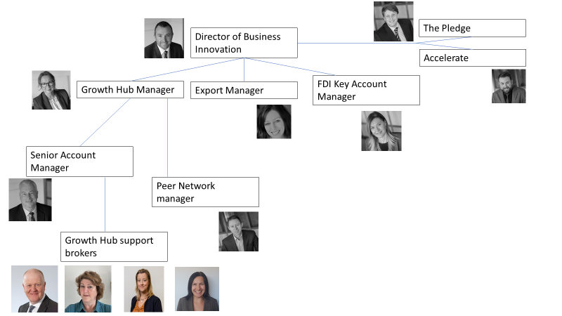

Slide 3
Progress in over last year
New chair and members
More strategic approach
Peer network delivery responsibility
Driven COVID business recovery strategy and delivery
Commissioned work on improving export
Leading work on Investment and Expansion

Slide 4
Responsibilities and decisions
Oversight of Growth Hub and business growth activities
Business Growth Strategic leadership
a mechanism to support strategic vision and leadership across business growth and business support in C&W
matching business demand to the supply of business support/influencing policy decisions
Ensuring strong private sector leadership/representation and supported by public stakeholders with the ability to make decisions and influence others.

Slide 5
Selected 2021/22 KPIs
100 referrals to a start up programme
1000 signposts/referrals to business support opportunities
40% Total referrals on programme/take up
Support 400 businesses to understand and adapt to new EU trading arrangements
Support 1500 unique businesses that require support
25,000 unique visitors to the GH webpaes
Establish 25 new exporters across Cheshire and Warrington
Increase existing exporters to new markets
Secure new investment in Cheshire and Warrington businesses of at least £1m
Support the creation of 500 jobs
Production of 20 case studies on range of topics
Raise awareness of Low Carbon agenda
550 Businesses - light touch support
200 Individuals - light touch support
600 Businesses - medium intensity support (IDB)
Combined T/o of businesses receiving med intensity support
Combined emps of businesses receiving med intensity support
150 Businesses - high intensity support
Combined T/o of businesses receiving high intensity support
Combined emps of businesses receiving high intensity support
Businesses receiving med /high intensity support that are scale-ups
Total number of individuals helped to start a business

Slide 6
Healthy​ | Sustainable​ | Inclusive​ | Growing​
We will deliver locally on the government’s healthy ageing mission to ‘achieve an additional five years of healthy, independent life by 2035, while narrowing the gap between the experience of the richest and poorest’​ | We will demonstrate leadership on sustainable growth. We recognise the value of our natural environment and will work to ensure that whilst securing sustained growth the environmental benefits of our activities outweigh the costs.​ | Cheshire and Warrington will be a place where people, regardless of their background or circumstances, are helped to ‘live their best lives’​ | We will be the UK’s fastest growing economy, making the most of new opportunities inside and outside of the EU, driven by innovation and a top location for people and business to live, work, invest and relax​
Halve levels of economic inactivity by 2030​ Achieve scores of >8 and increasing on the ONS Population Survey Personal Wellbeing measure of Life Satisfaction​ ​ Achieve scores below the England Mean for estimated prevalence of mental health disorders​ ​ Reduce the difference in life expectancy at birth between most and least deprived by xx% by 2035​ | Reduce our Carbon Footprint by at least 2.5MtCO₂ per year through development of Net Zero industrial cluster in Birchwood and Ellesmere Port by 2030​ Cheshire and Warrington is a Net Zero economy by xx in alignment with local authority climate plans​ Double use of active travel, sustainable transport and walking by 2025​ ​ [Measure linked to increasing bio-diversity, natural capital, and reducing resource use – awaiting baseline from Natural Capital Audit]​ | Eliminate in work poverty by xx​ Halve the number earning below the real living wage by 2025​ ↑ % workers and residents engaged in learning​ ↓ % residents experiencing digital exclusion​ Strengthen our talent pipeline to ensure equality of opportunity for women and girls and our BAME and LBGTQ+ communities​ ​ | Increase size of economy by xx by 2040​ ​ Employment and economic activity levels above 2019 rates by 2025​ ​ GDP per hr growing c.f. rest of UK​ ​ Combination of public and private sector R&D spend >3% of our GDP, with Cheshire and Warrington participating fully in relevant national programmes. ​

Slide 7
2021/22 Goals ​
Healthy​ Develop and make available to all businesses a mental health toolkit Work alongside partners to develop a start up programme targeted at hard to help areas providing a way to improve personal wellbeing and life satisfaction Partnership with Active Cheshire to encourage healthy workforce for all Cheshire and Warrington employers | ​
Sustainable​ Develop and offer toolkit to businesses on how to reduce carbon footprint Alongside NW energy hub and other partners develop bespoke low carbon business support strand Develop Inward Investment strategy taking into account opportunities in specific, agreed targeted sectors (Clean Growth/Hydrogen, Financial Services, Life Sciences, Nuclear etc). | ​
Growing Identify and account manage at least 50 growing businesses with the intention of creating a new scale up cohort Provide the opportunity for growing businesses and scale ups to access high level support through national and international scale up and sector programmes Deliver a high quality peer network for 100 SMEs in order for them to progress to next growth stage
Inclusive​ Map business support activities across Cheshire and Warrington ensuring all communities are served Offer support to businesses to develop inclusive policies and practices Develop and offer toolkit to businesses to assist in removing common barriers | ​

