Slide 1

Agenda Item 7
C&W Future Economic Strategy
Context - Post-Covid, post-Brexit, post-COP26, post-budget and spending review, and responding to climate change and net zero, shortages/inflation, workforce trends, energy price spike etc
Need to re-cast economic strategy in terms of the new vision – healthy, sustainable, inclusive and growing
Government policy for economic development still uncertain i.e.
  Levelling Up White Paper
  LEP Review
LEP Recovery Plan runs to spring 2022
Previous economic strategy in need of review - LIS / SEP associated with previous economic landscapes
LA’s & LEP commissioning work on a potential ‘Levelling Up Deal’ – overlap with future economic strategy
Update of overarching subregional economic strategy needed
  Propose to bolt-on economic strategy refresh to Levelling Up Deal
  Main strategy to be developed prior to any sub-strategies being refreshed or commissioned
  The work needs to consider new angles and may be radically different from previous as the LEP and subregion adapt to new context
The following slides give a visual overview of current situation and proposal
Recommendation: For SPB to comment on the proposal and next steps for refreshing economic strategy

Slide 2
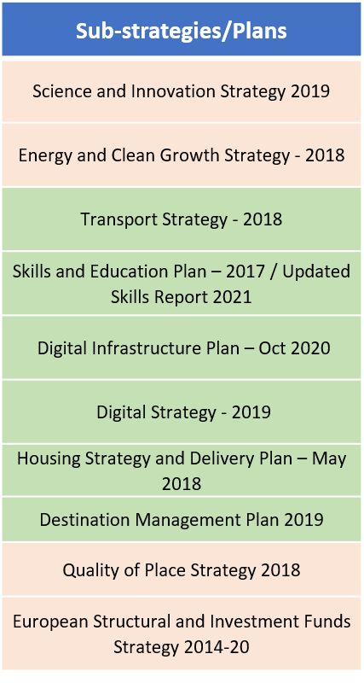
Cheshire and Warrington Economic Strategies – Existing 2021
Recovery Plan
2021/22
Local Industrial Strategy
2019/20 to 2030 (not formally adopted)
Strategic Economic Plan
(Refresh 2017) to 2040
Inclusive Growth Prospectus - 2018
LEP Delivery Plans - annual
CSR Submissions - annual
Policy/consultancy commissions e.g. Up There Everywhere Perceptions Report 2020 / Life Sciences Cluster Work 2021 / Natural Capital Audit & Investment Plan

Slide 3
Cheshire and Warrington Economic Strategies – Future
NATIONAL POLICY - existing
CSR 2021
Plan for Growth (replaces Industrial Strategy)
Net Zero Strategy & Heat and Buildings Strategy
Hydrogen Strategy
Innovation Strategy
Plan for Jobs
Transport Decarbonisation Plan
Energy White Paper
Life Sciences Vision
10 Point Plan Green Industrial Revolution
Green Jobs Taskforce report
Future C&W Economic Strategy
Vision/Strategy/Plan/Evidence Annex Timeframe TBC
Key Considerations
Currently the proposed County / Levelling Up Deal and responding to the Levelling Up agenda is of critical policy importance to the subregion
Future Economic Strategy to be re-cast to complement Levelling Up Deal proposals and to deliver new vision - inclusive, healthy, sustainable, growing
Work must take account of new economic landscape post-Brexit, post-Covid, post-COP26, post spending review and with further challenges of climate change and net zero, energy price spike, workforce trends and shortages/inflation etc.
Recovery Plan
2021/22
NATIONAL POLICY - forthcoming
LEP & DMO Reviews (Nov-Dec 2021?)
Levelling Up White Paper (inc Devolution/Innovation) (Nov-Dec 2021?)
Local Industrial Strategy
2019/20 to 2030 (not formally adopted)
Strategic Economic Plan
(Refresh 2017) to 2040
Inclusive Growth Prospectus - 2018
LEP Delivery Plans - annual
CSR Submissions - annual
Policy/consultancy commissions e.g. Up There Everywhere Perceptions Report 2020 / Life Sciences Cluster Work 2021 / Natural Capital Audit & Investment Plan

